Slide 1
Create a free trial AWS account and access Services

Slide 2
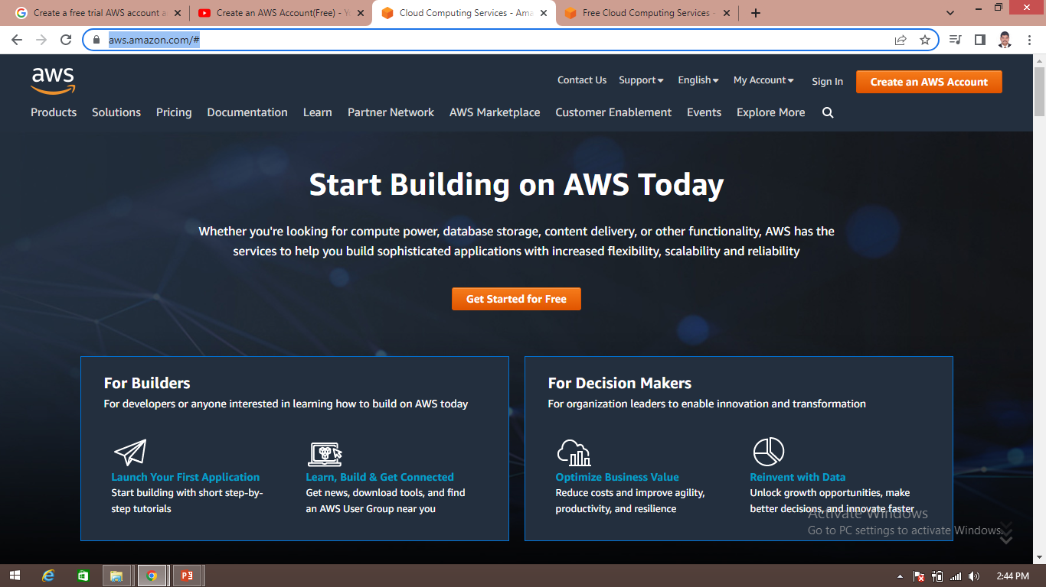
How to create a free trial AWS account
Step 1: open https://aws.amazon.com

Slide 3
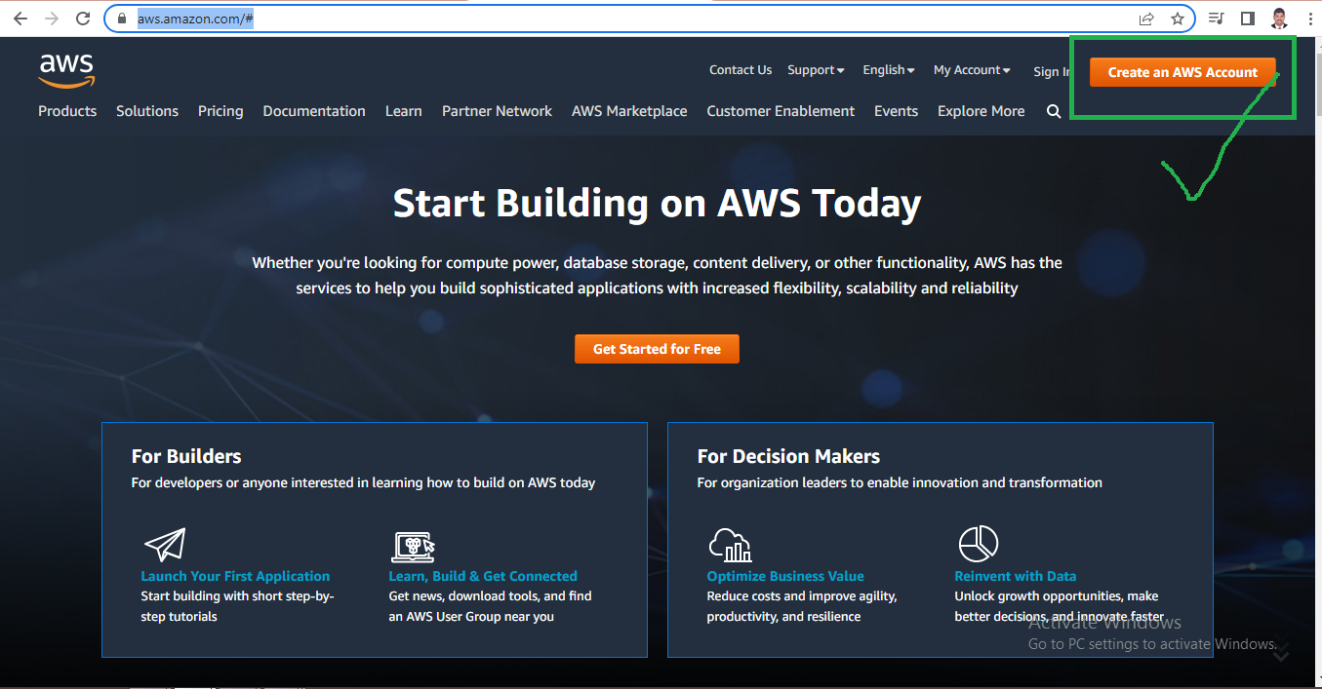
How to create a free trial AWS account
Step 2: click on create AWS account

Slide 4
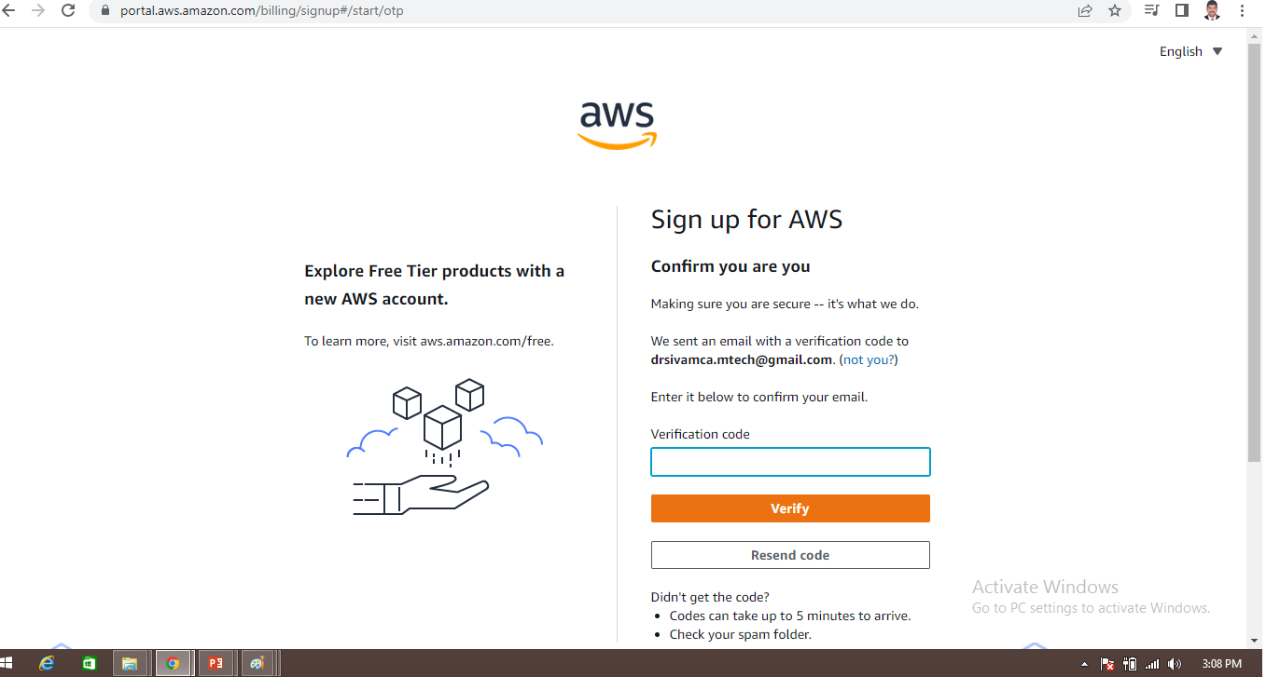
How to create a free trial AWS account
Provide email id and name details for AWS account creation then a screen will appear as below

Slide 5
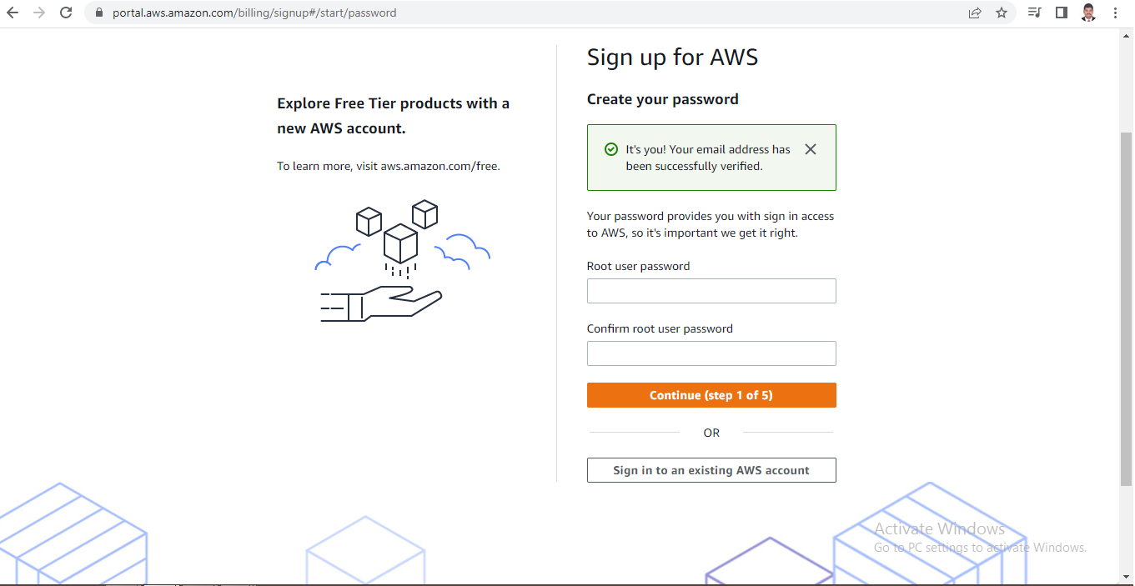
How to create a free trial AWS account
Enter verification code received in your mail
Provide password

Slide 6
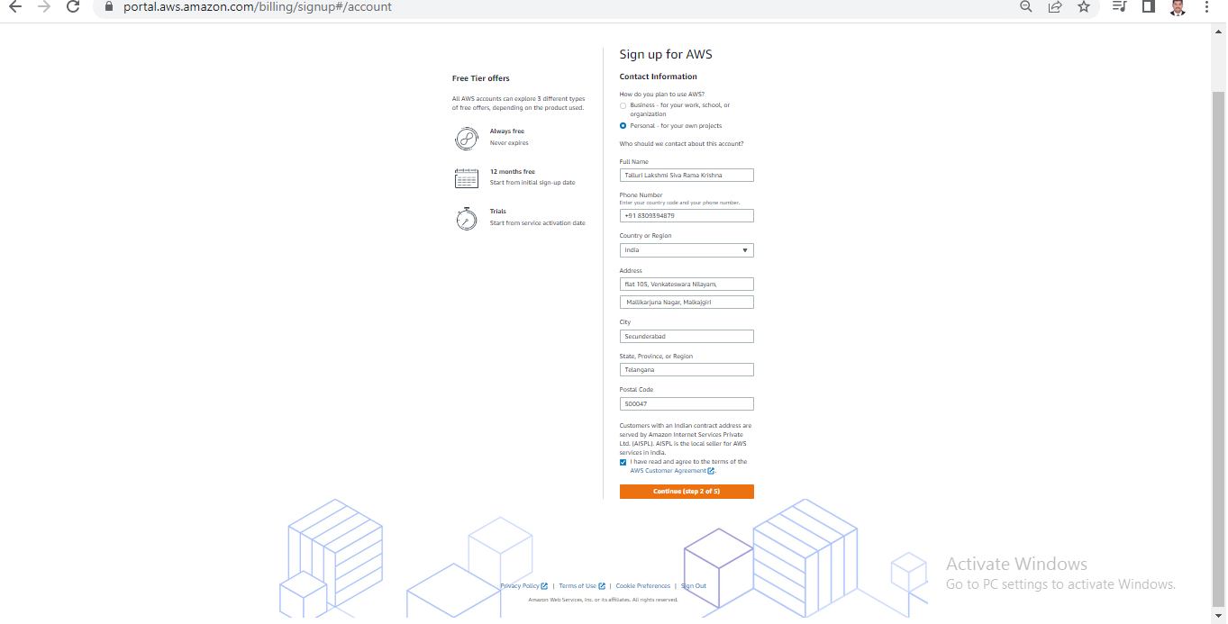
How to create a free trial AWS account
Provide your contact details and agree Terms and conditions, then click on create

Slide 7
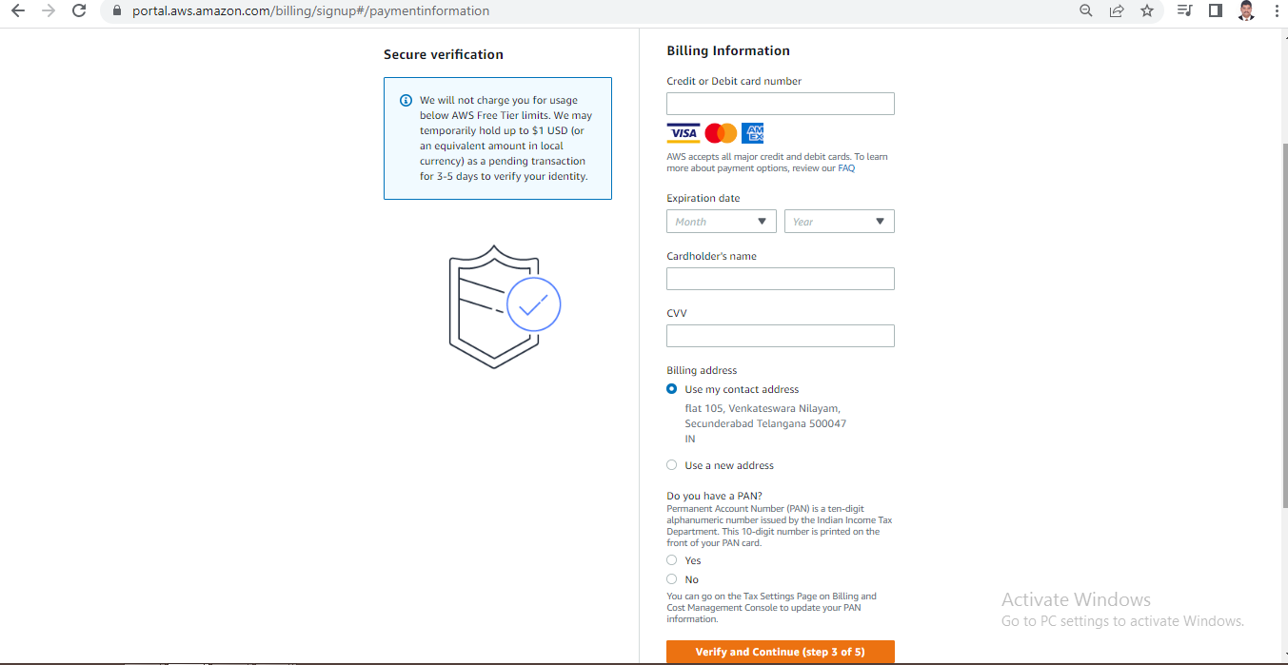
Provide billing details, click on verify and continue

Slide 8
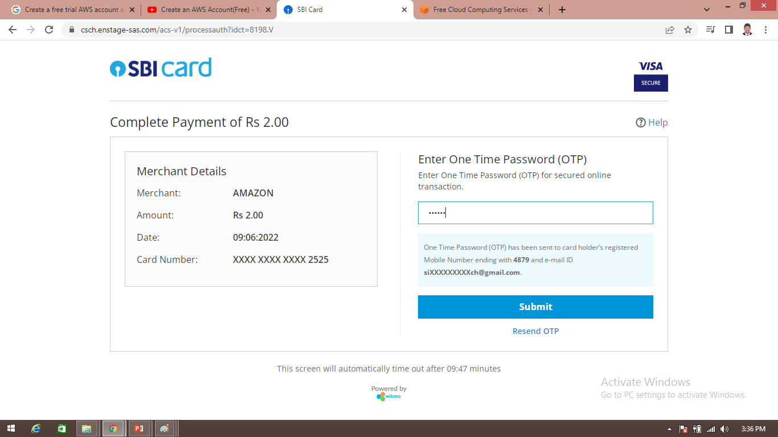
Amazon chagres 2 rs and it will be credit back into your account once verification is over

Slide 9
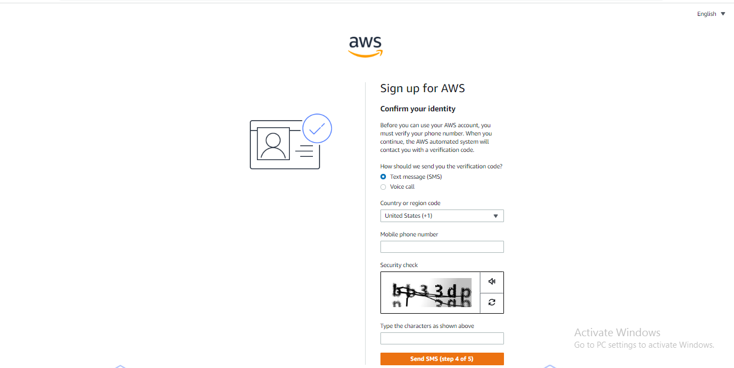
Once payment success a screen appear as below, provide your working contact number after selecting country, and click on send SMS after entering the details

Slide 10
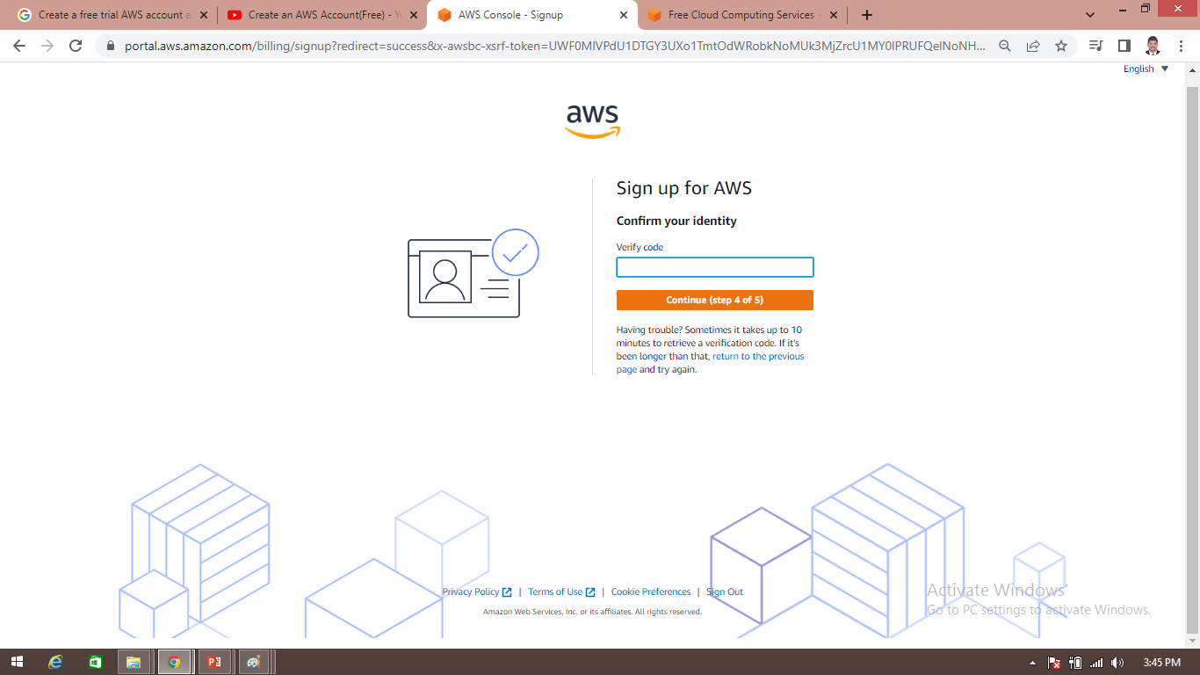
Provide verification code received in your mobile

Slide 11
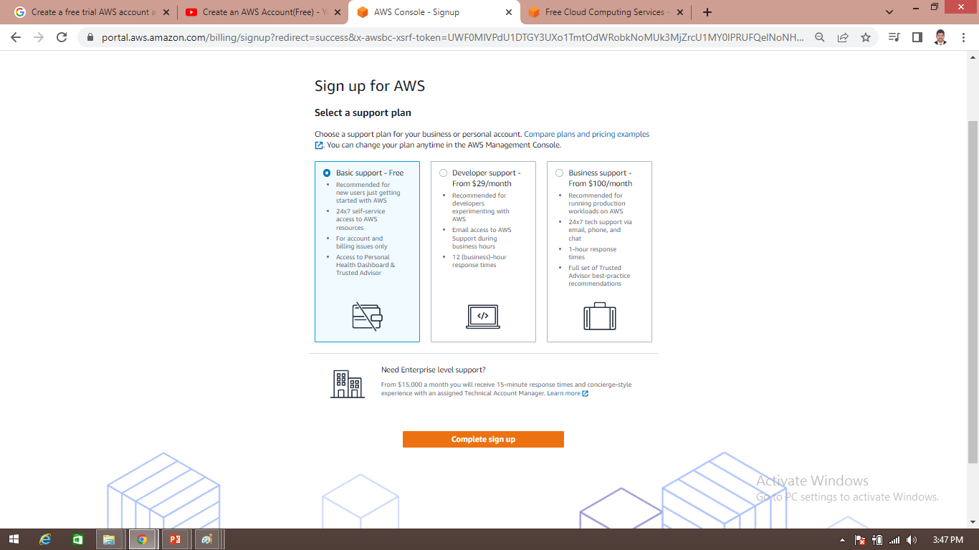
Now select basic plan and click on complete sign up

Slide 12
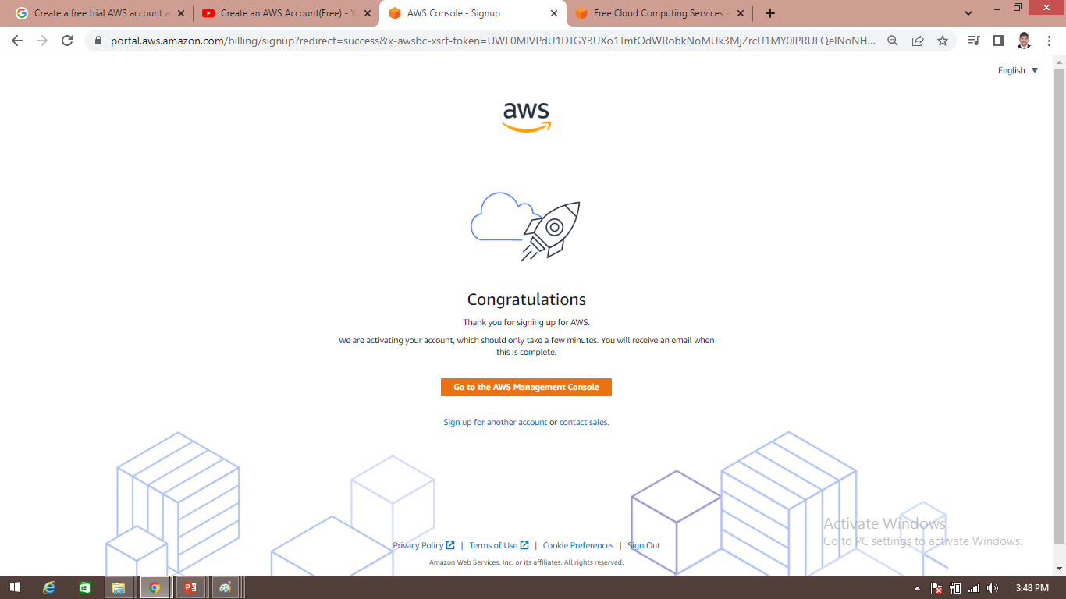
Now a screen appear as follows then click on AWS management console

Slide 13
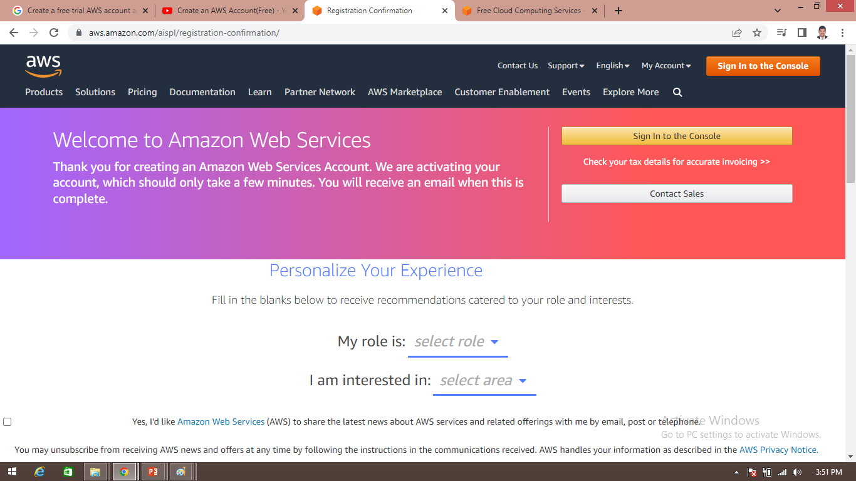
You can see screen like this

Slide 14
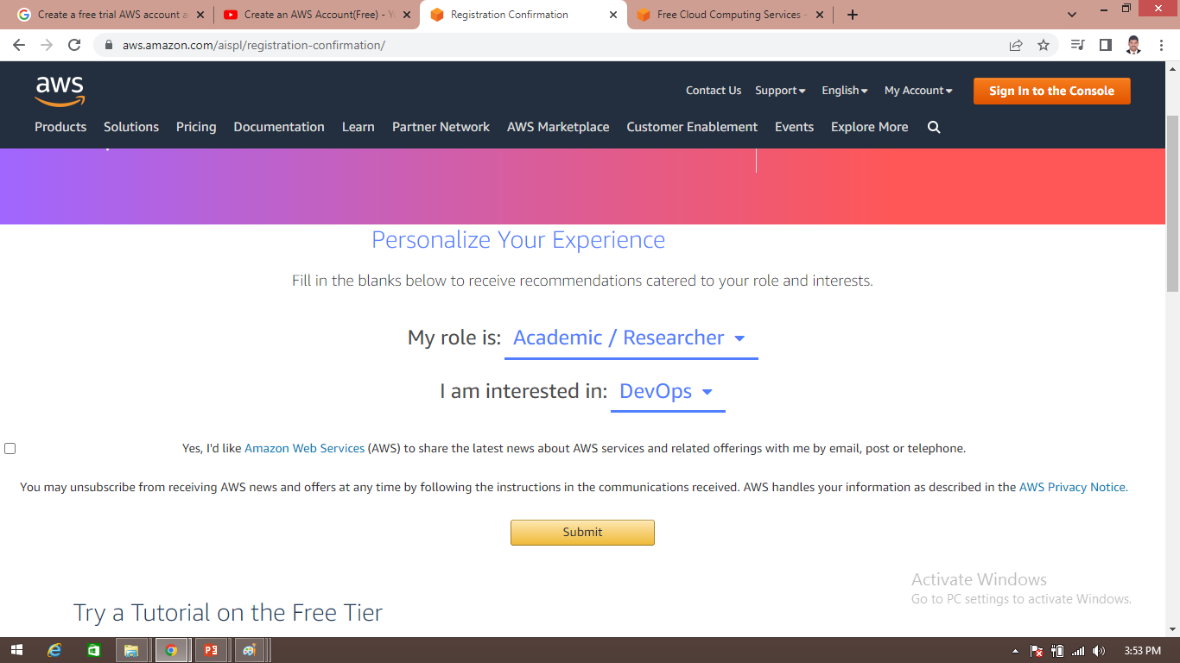
Select role as Academic/Researcher and interest as DevOps and click on submit

Slide 15
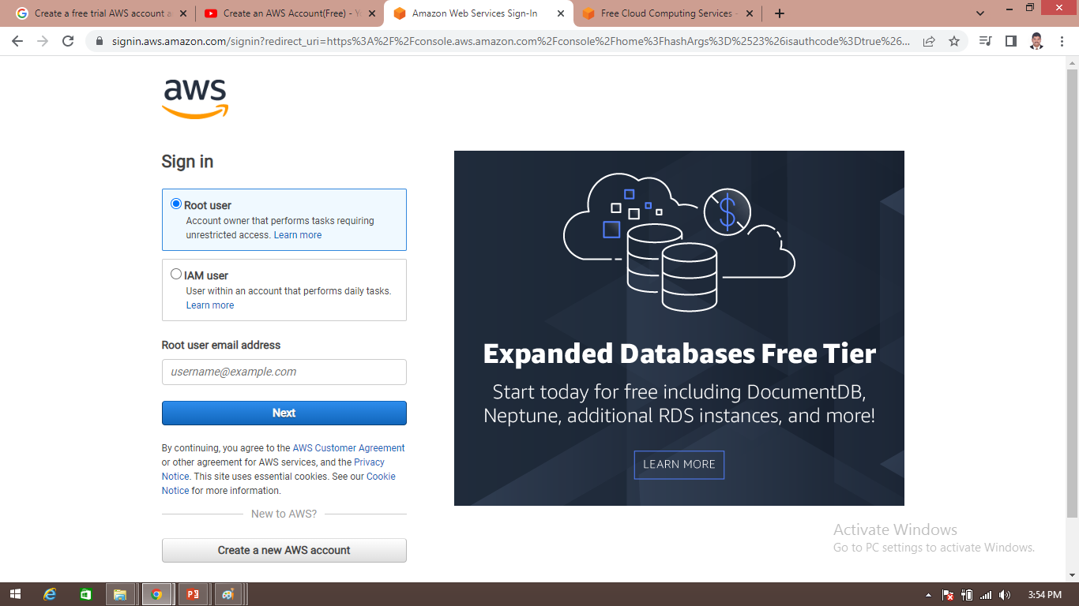
Accessing AWS services
Sign into AWS console as Root user

Slide 16
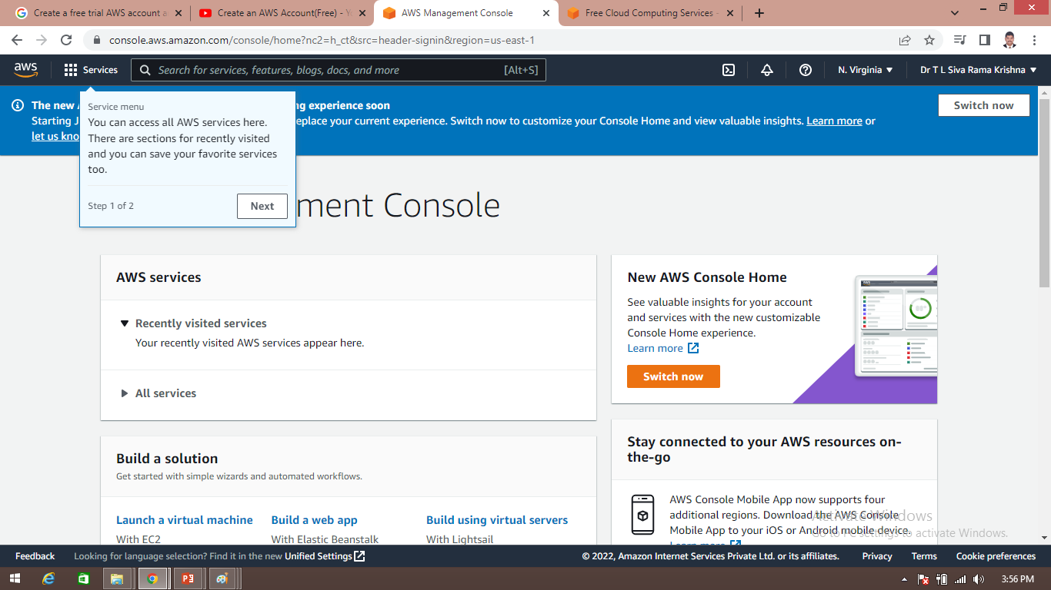
A console screen appears like this

